Slide 1
Android Coding Standard
Shivam Srivastava

Slide 2
Documentation
The purpose of a business requirements document is to give a complete picture of a project or new business plan, so everyone is clear on what must be done and when. The document should include:
A summary statement, sometimes called an executive summary, which outlines the project requirements in general.
The objectives of the project, These objectives should be in SMART format; specific, measurable, attainable, realistic, and time-bound.
Functional Requirements
Descriptions of data to be entered into the system.
Operations performed by each screen.
Data to be shown and hide on screen.
Work-flows performed by the system.
Schedule, timeline, and deadlines, Phases of the project should be detailed in this section, to make sure all parties understand what is required and when. in the XYZ project.

Slide 3
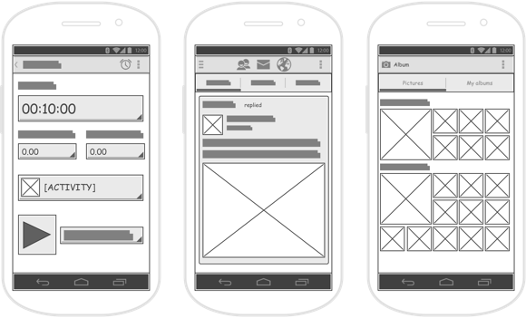
Design Mockups -Wireframes

Slide 4
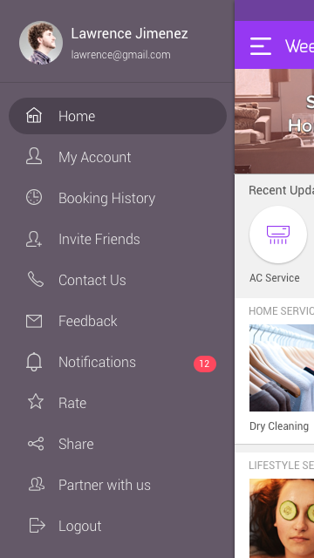

Design Mockups -

Slide 5
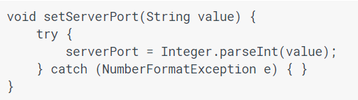
Development
Don't ignore exceptions

Slide 6
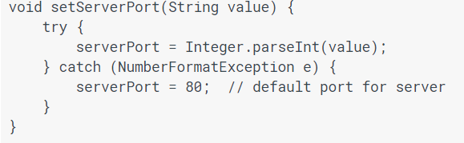
Development
Handle the error
Set default value
Show Toast to user
Close any resource –if using

Slide 7
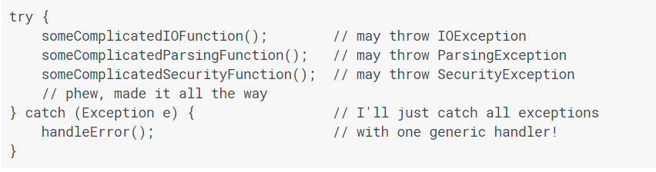
Development
Don't catch generic exception
Handle appropriate error within each exception

Slide 8

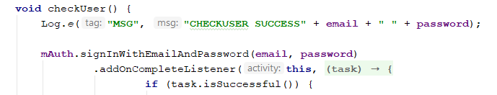
Development
Mention Access Specifier

Slide 9
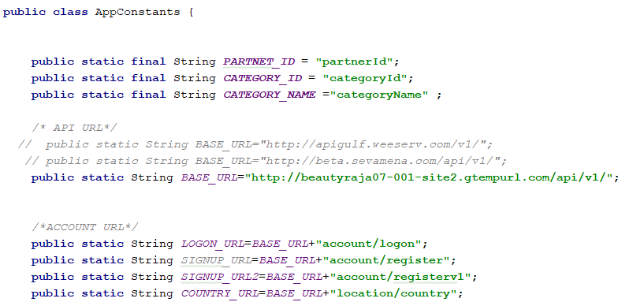
Development
Use AppConstants for contant/final values
Intent Keys
Server Base URL
SharedPreference keys
JSON Parsing keys

Slide 10
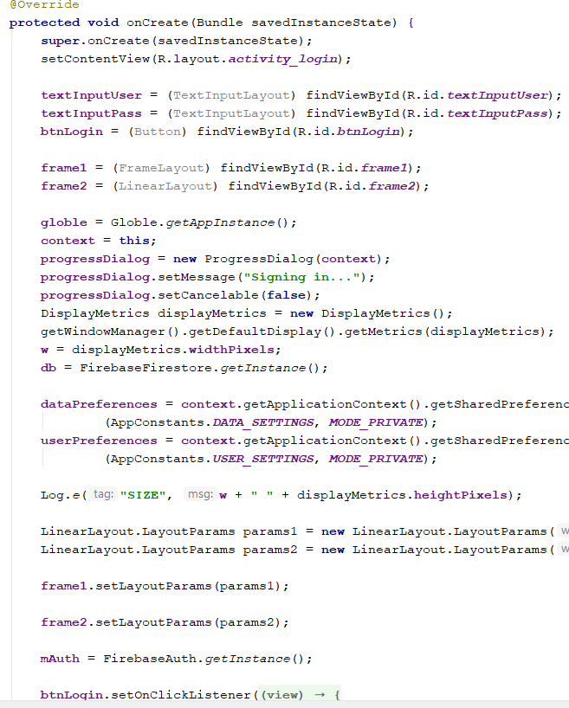
Development
Avoid writing each line of code within onCreate() or any function

Slide 11
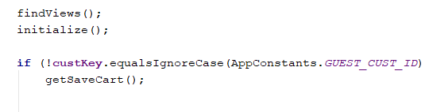
Development
Write code in functions
Easy to manage functionalities

Slide 12
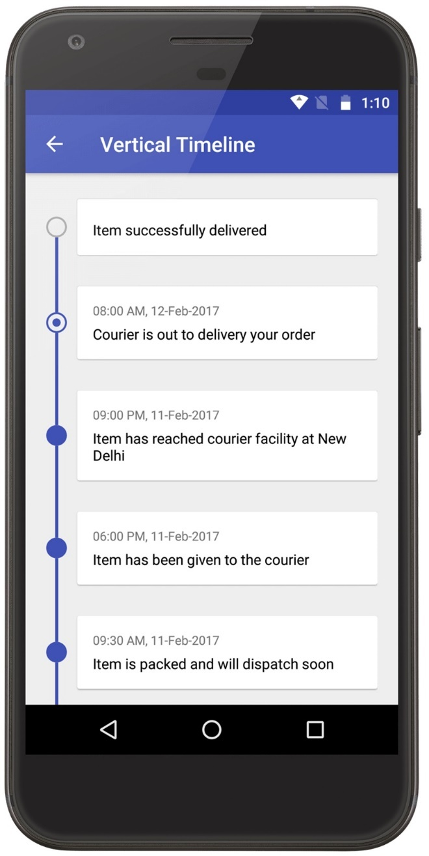
Development
Make app functionality in modules
RecycleView
orderKey=12345 by Intent
Navigation
orderKey=12345 by Intent
Notification
orderKey=12345 by Intent

Slide 13
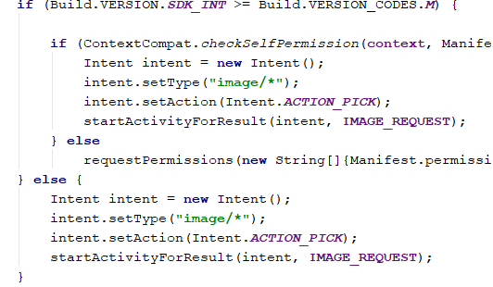
Development
Check Version and Runtime Permission each time

Slide 14

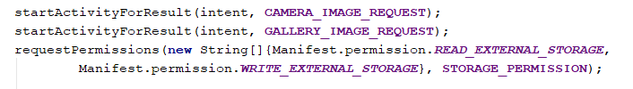

Development
Create and use final REQUEST_CODE
Use Android Result code wherever posssible

Slide 15

Development
Use Java and Android API’s

Slide 16
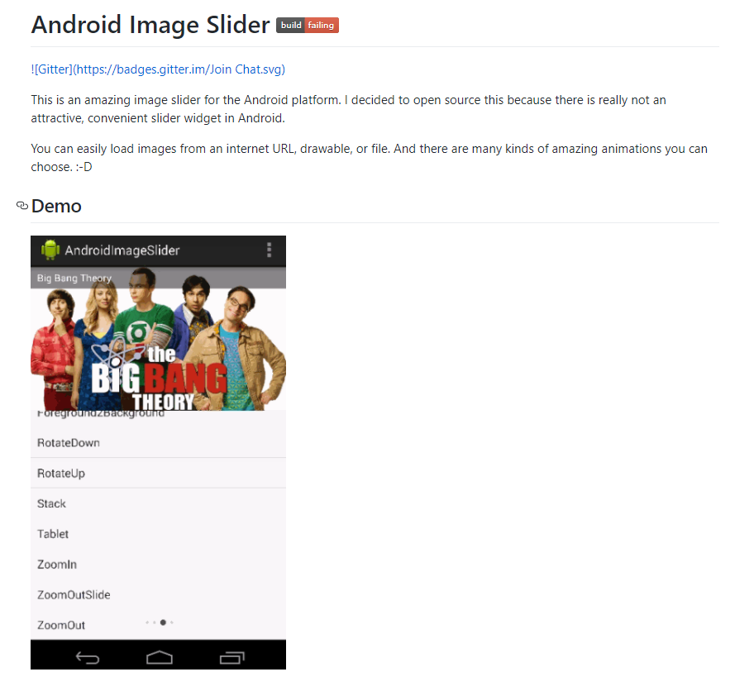
Development
Use less Libraries

Slide 17
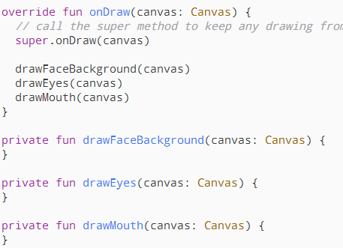
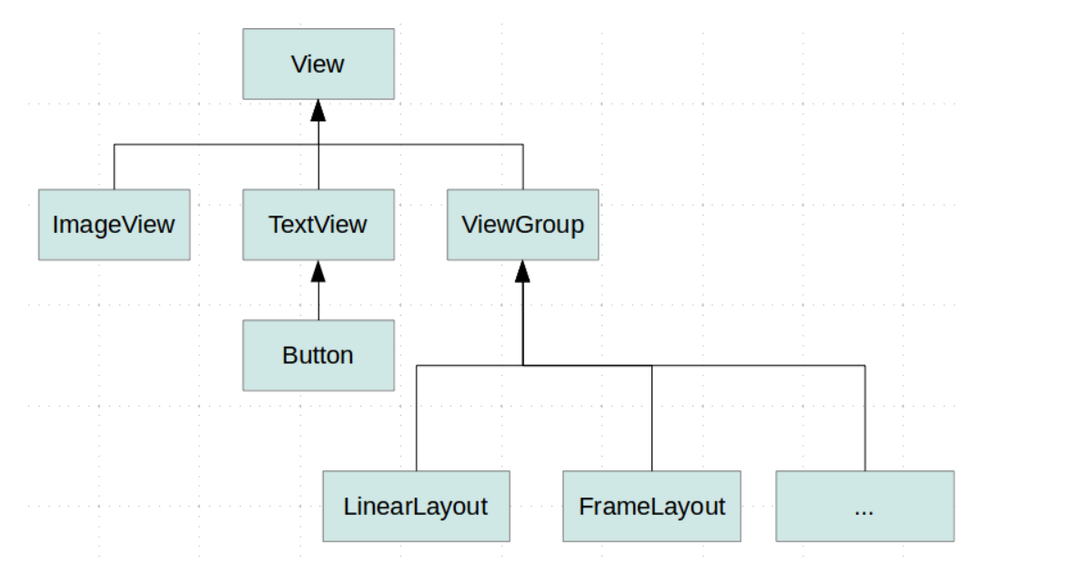
Development
Create and learn own libraries

Slide 18
Testing
Checking inputs fields type
Device screen compatibility
Android versions test - 5.0,6.0, 7.0
Performance
Logic Test
Creating Testing Server
Server Communication

Slide 19
Tips
Learn Algorithm
Practice Loop and If’s
Practive

